Slide 1

Computer and Network Security COMP 5370/637* Lecture #4 August 24, 2015
Tony Skjellum
skjellum@auburn.edu

Slide 2
Today’s Topics
Finish topic from last lecture
Discuss Networking Basics

Slide 3
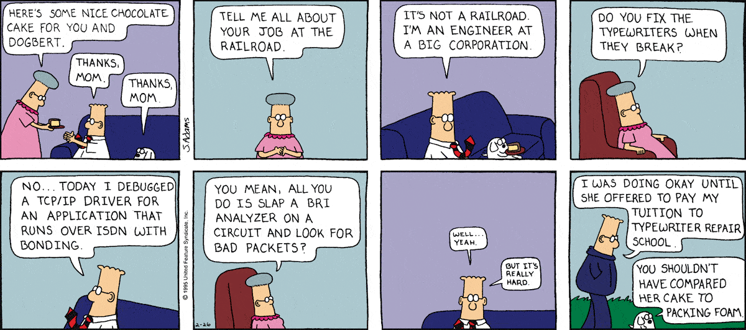
Dilbert’s take on network engineering
http://dilbert.com/search_results?terms=tcp

Slide 4
To Do’s from Last Time
Read Chapter 1 of Bishop
Finish up last comments on levels & lattices

Slide 5
Levels and Lattices
Domination
implements "comparable"
(A, C) dom (A′, C′) iff A′ ≤ A and C′ ⊆ C
Which Dominates?
(Top Secret, {NUC, ASI}) |  | (Secret, {NUC})
(Secret, {NUC, EUR}) |  | (Confidential,{NUC, EUR})
(Top Secret, {NUC}) |  | (Confidential, {EUR})

Slide 6
Information Flow … again
Information flows in one direction only
“Reads up” disallowed, “reads down” allowed
Subject s can read object o iff L(s) dom L(o) and s has permission to read o
“Writes up” allowed, “writes down” disallowed
Subject s can write object o iff L(o) dom L(s) and s has permission to write o
Note the combination of mandatory control (relationship of security levels) and discretionary control (the required permission)
If a system is initially in a secure state, and every transition of the system satisfies these conditions and the ★-property, then every state of the system is secure

Slide 7
Adjustments
(A, C) dom (A′, C′) iff A′ ≤ A and C′ ⊆ C
then (TS, {NUC}) ¬dom (Confidential, {EUR})
and (TS, {NUC, EUR}) ¬dom (TS, {EUR})
in general
A ≥ A' and C'⊂C prevents read down and write up
does this make sense, especially with:
(TS, {NUC, EUR}) ¬dom (TS, {EUR})

Slide 8
Adjustments (con't)
Define maximum, current levels for subjects
allow subject to downgrade within level as long as
maxlevel dom curlevel
Example
Let
Bob have maxlevel(TS, {NUC, EUR})
Sue have maxlevel(TS, {EUR})
Bob sets curlevel to (TS, {EUR})
Now, L(Sue) dom L(Bob)
Bob can write to Sue without violating "no writes down"
but, Bob assumes responsibility for not leaking information to a different compartment
Traditional approach in military:
Linear model among levels levels
Lattice model within highest level

Slide 9
Networking Basics – 7 layer model
7. Application
6. Presentation
5. Session
4. Transport
3. Network
2. Data Link
1. Physical

Slide 10
1. Physical
The medium
String
Coax
Cat-6
The air (wireless)
Electrical or electromagnetic
No data semantics
Examples: Wireless Ethernet, 1000 BaseT over fibre optics, InfiniBand over fibre optics, Ethernet over Cable company Coax

Slide 11
2. Data Link
Responsible for framing the data
Rules for encoding and decoding units of transfer (packets or frames)
May or may not have error detection
Usually do not have…
Reliability of transmission
Reliability of delivery
confidentiality, or proof of where the data came from
Ex: 1504-byte Ethernet frames over Cat-6 (802.11)

Slide 12
3. Network
Generalizes the concepts of single networks into multiple networks
Adds coarse-grain addressing, routing
Does not have to add:
Reliability
Security
Supports moving between different physical media

Slide 13
4. Transport
Features
Additional addressing for multiplexing and demultiplexing
May provide reliability
Can provide security
May provide source authenticity
Ex: Address to a port, instead of to a machine
May add optional encryption (point-to-point)
Traditionally no security

Slide 14
5. Session
Creates state between hosts to support transfers
Addresses
Logical “connection” for connection-oriented
Authentication
Logical set of protocols built on the transport chosen
Remember “A session is needed to present something via an application”

Slide 15
6. Presentation
How data is formatted in a given session
ASCII, EBCDIC(?), ISO ?
Byte ordering (usually NBE but can be different!)
Data structures marshaled and unmarshaled across the network
Meaning of the data (semantics)
Protocol for interchanging information (e.g., client-server, peer)

Slide 16
7. Application
Application-to-application communication
Client server
Web browser to web server
ftp client and ftp server
Rich clients for doing your taxes with online storage of forms
Peer protocols (Napster, Bit torrent)
Provides the interfaces that provide services of value to user

Slide 17
Internet Protocol Suite
Compresses the ISO OSI RM
4 layers – Link, Internet, Transport, Application
This is practically what is used, vs. theory

Slide 18
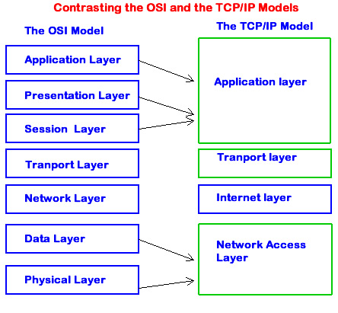
Contrasting OSI and TCP/IP Models

Slide 19
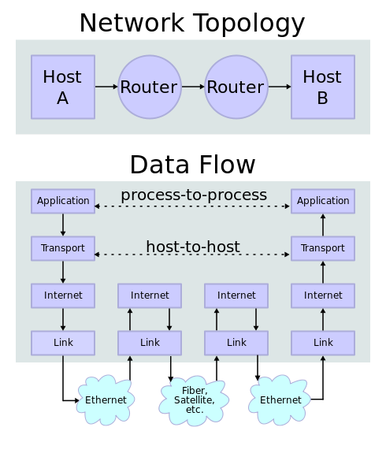
Internetworking

Slide 20
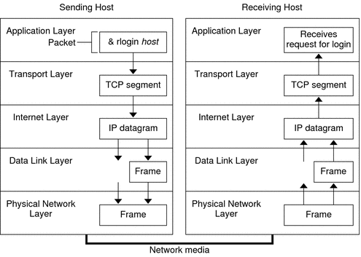
Internetworking

Slide 21
Where do
Confidentiality
Integrity
Availability
come in? They don’t automatically!

Slide 22
How do we get security
We have to layer a protocol on top of TCP/IP
Must be connection-oriented!
HTTP – web browser protocol (application-to-application)
HTTPS – web browser secure protocol
How implemented
SSL – Secure Socket Layer
TLS – Transport Layer Security
https://community.thawte.com/blog-posts/difference-between-ssl-and-tls

Slide 23
Reminder!
Bishop
Information Assurance
Confidentiality
Integrity
Availability
Only authorized parties can access information
Information transactions cannot take place without authorization or without detection
Information must be available when needed
Information transactions must be guaranteed to be authentic
No legitimate transaction can be renounced as illegitimate.

Slide 24
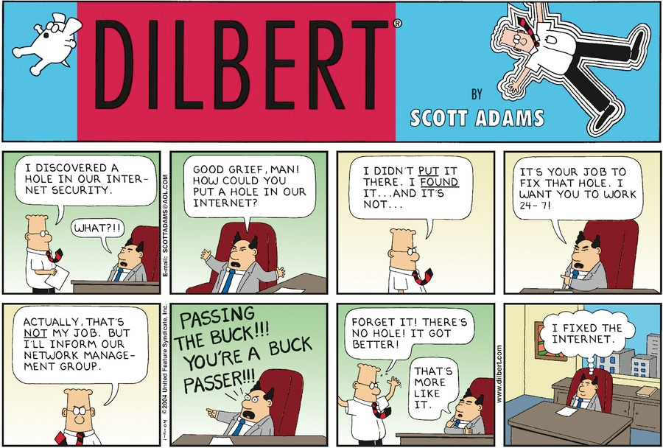
Dilbert’s take on network security
http://dilbert.com/search_results?terms=network+security

Slide 25
To Do’s
Study ISO OSI RM (7-layer model)
https://en.wikipedia.org/wiki/OSI_model
Compare: Internet Protocol Suite
https://en.wikipedia.org/wiki/Internet_protocol_suite
Begin reading article on HTTPS
http://robertheaton.com/2014/03/27/how-does-https-actually-work/

Slide 26
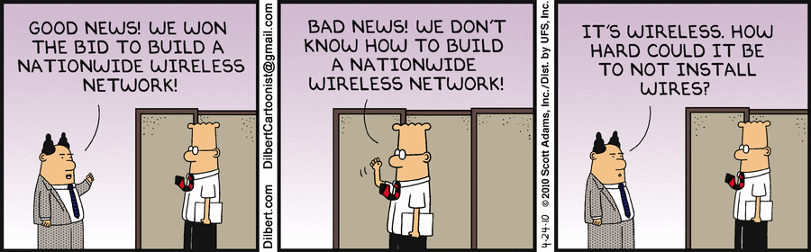
BACKUP

Slide 27
What is TLS?
In 1999, TLS technology was designed to create a standard encryption for private communication. The object of TLS is to stop eavesdropping, message forgery and tampering. TLS (Transport Layer Security) is designed to provide a complete cryptographic security layer to the confidential information transmitting between servers. The TLS protocol is built on two layers.
The TLS Record Protocol: The Record Protocol deals with private connection that established between the client and the server. It uses symmetric cryptographic keys to ensure a private connection. Such connection can be secured through the hash functions. MAC (Message Authentication Code) generates such hash functions.
The Handshake Protocol: The Handshake Protocol allows legitimate communication between the server and client. This protocol assures that both server and client agree upon a same encryption and keys before sending data between them. It creates authenticity for the server and client.
Ref: https://community.thawte.com/blog-posts/difference-between-ssl-and-tls

Slide 28
What is SSL?
What is SSL?
SSL (Secure Socket Layer) is a secure communication protocol that provides privacy and reliability between two servers or applications. SSL version 3.0 is the current version used in the internet community. SSL provides a strong encryption to users so attacker cannot read the information travelling between servers.SSL works on private and public key that is used to encrypt and decrypt the information by users. SSL is built on four layers, which are as under.
Record Layer: The Record layer provides a header for the message, a hash, and MAC (Message Authentication Code). In record layer, the application message is divided into blocks. The protocol message should not exceeded than 16.384 bytes. Then blocks are compressed whose content should not exceeded than 1024 bytes. After that, authenticated code is passed over compressed data with a private key. The final step is to add a header to record layer. The SSL record layer provides confidentiality and message integrity. The compressed message and MAC are encrypted then with applying symmetric encryption.

Slide 29
What is SSL?
Change Cipher Spec Protocol: Change Cipher Spec Protocol consists of a single message that indicates the beginning of a communication between a client and server. The size of a Cipher Spec message is one byte with a value 1.
Alert Protocol: This protocol sends any errors emerged between two servers. It consists of two bytes carries the value 1(warning) and 2(fatal).Value 1 indicates specific alert and value 2 indicates about the termination of connection.
Handshake Protocol: Handshake protocol allows the client and server to negotiate on encryption, MAC, and cryptographic keys.It consists of a message series used by the server and client. Handshake protocol comprises four steps Client Hello, Server Hello, Server Key Exchange, Server Hello Done, Client Key Exchange, Change Cipher Spec, Finished, Change Cipher Spec, and Finished. At the end of handshake process, the user will see a padlock in his web browser that indicates a secure protocol has been set.

Slide 30
Differences between TLS and SSL
Alert Message: If a client has no certificate to use, he can pass a message “No Certificate” in TLS protocol. While in SSL, if a client has no certificate, there is no need for a separate message.
Message Authentication: TLS applies MAC (H-MAC) in many implementations while SSL uses MD5 and SHA. The benefit for using H-MAC is it can be operated by any hash function.
Key Material Generation: TLS applies the HMAC standard and PRF (pseudorandom function) to generate the key. SSL uses RSA, Diffie-Hellman, or Fortezza/DMS to generate key material.
Certificate Verify Message: In TLS, certificate verification message is already contained in the handshake message, which is already exchanged in session. In SSL, it requires a tough procedure to pass a certificate verification message.
Finished: In TLS, the finished message is created thorough PRF output with the help of “client finished” or “server finished” message. In SSL, the finished message is created in the same manner in which the key was generated. It uses cipher suite and parameter information.

